Slide 1

House Price Prediction
Birla Vishvakarma Mahavidyalaya Engineering College
Information Technology Department
Group No. :- 13
Kalp Gohil 18IT405
Param Shah 18IT413
Man Desai 18IT404
Jay Patel 17IT419

Slide 2
Objective of the House Price Prediction
The goal is to predict the price of a given house according to the market prices taking into account different “features”.
Main objective in this project is to obtain reasonably good to predict house prices based on some variables included in the dataset.

Slide 3

Aim of Our Project
We will analyze data collected.
According to that we will clean and pre-process the data.
And then we will train model on this cleaned data.

Slide 4
Modules
Data Collection.
Data Pre-Processing.
Data Cleaning.
Dealing with NULL values.
Data Transformation.
Attribute Selection.
Model Training.
Designing for website (User Interface).

Slide 5
Description of Modules
Data Pre-Processing :-
After having dataset in hands, its important to pre-process that raw data into useful form.
Data Cleaning :-
In this module we had cleaned our dataset if it has any null values using following techniques..
Drop that null data.
Fill that null data with some meaning full statistical value.

Slide 6
Description of Modules
Data Transformation.
After data cleaning, we had transformed our data in appropriate form to remove outliers.
Attribute Selection :-
In this strategy we had add some new columns to our data set from existing ones to have look inside from data.
Aggregate function can be used on two or more columns to have new column that may have highly positive or highly negative correlation with target value.

Slide 7
Description of Modules
Model Training.
Now data is all set to be trained. But How….??
So, it is required to select an appropriate training method to train model.
So, understanding relationship between various set of attributes using histograms, pie charts, bar graphs, etc can help one to select best method to train model

Slide 8
Description of Modules
Designing for website (User Interface).
One simple website has been created to deploy this model.
Django framework is used for same.
Login/Sign Up functionality are there in the website.
User can easily login and then only he/she will be able to predict price of the house.
As a database, Django inbuilt SQLite is used.

Slide 9
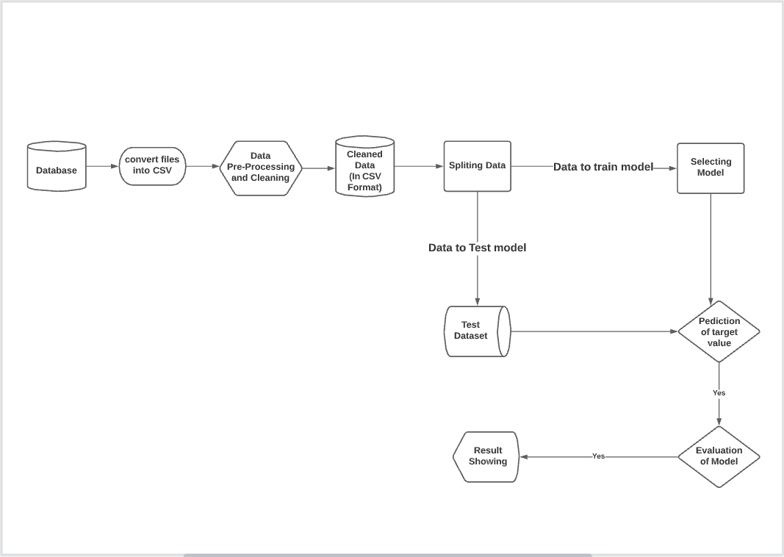
Flow of Model Training

Slide 10
Thank You…!!

